Slide 1
Human factors in Design and Engineering
9/04/2018
Kavita vemuri

Slide 2
Why?
The principles of Human Factors Engineering will provide a comprehensive understanding of the main factors involved in cognitive, physical, environmental, and psychophysiological approaches.
The process will demonstrate how the characteristics and capabilities of people can be taken into account in order to optimise the design of things used by people, the environments in which they live and work, and the organisation of systems.
An appreciation of Human Factors principles is required to know these have an impact in the design and evaluation process of simple and complex sociotechnical systems.
HF combines theoretical analysis with practical applications.

Slide 3
Validating the Methods Selection and Ergonomics Intervention Process

Slide 4
Human factors
1. Data collection techniques.
2. Task analysis techniques.
3. Cognitive task analysis techniques.
4. Charting techniques.
5. Human error identification (HEI) techniques.
6. Mental workload assessment techniques.
7. Situation awareness measurement techniques.
8. Interface analysis techniques.
9. Design techniques.
10. Performance time prediction/assessment techniques.
11. Team performance analysis techniques
All content from reference book:
Stanton – Human Factors Methods-a practical guide to design and engineering

Slide 5
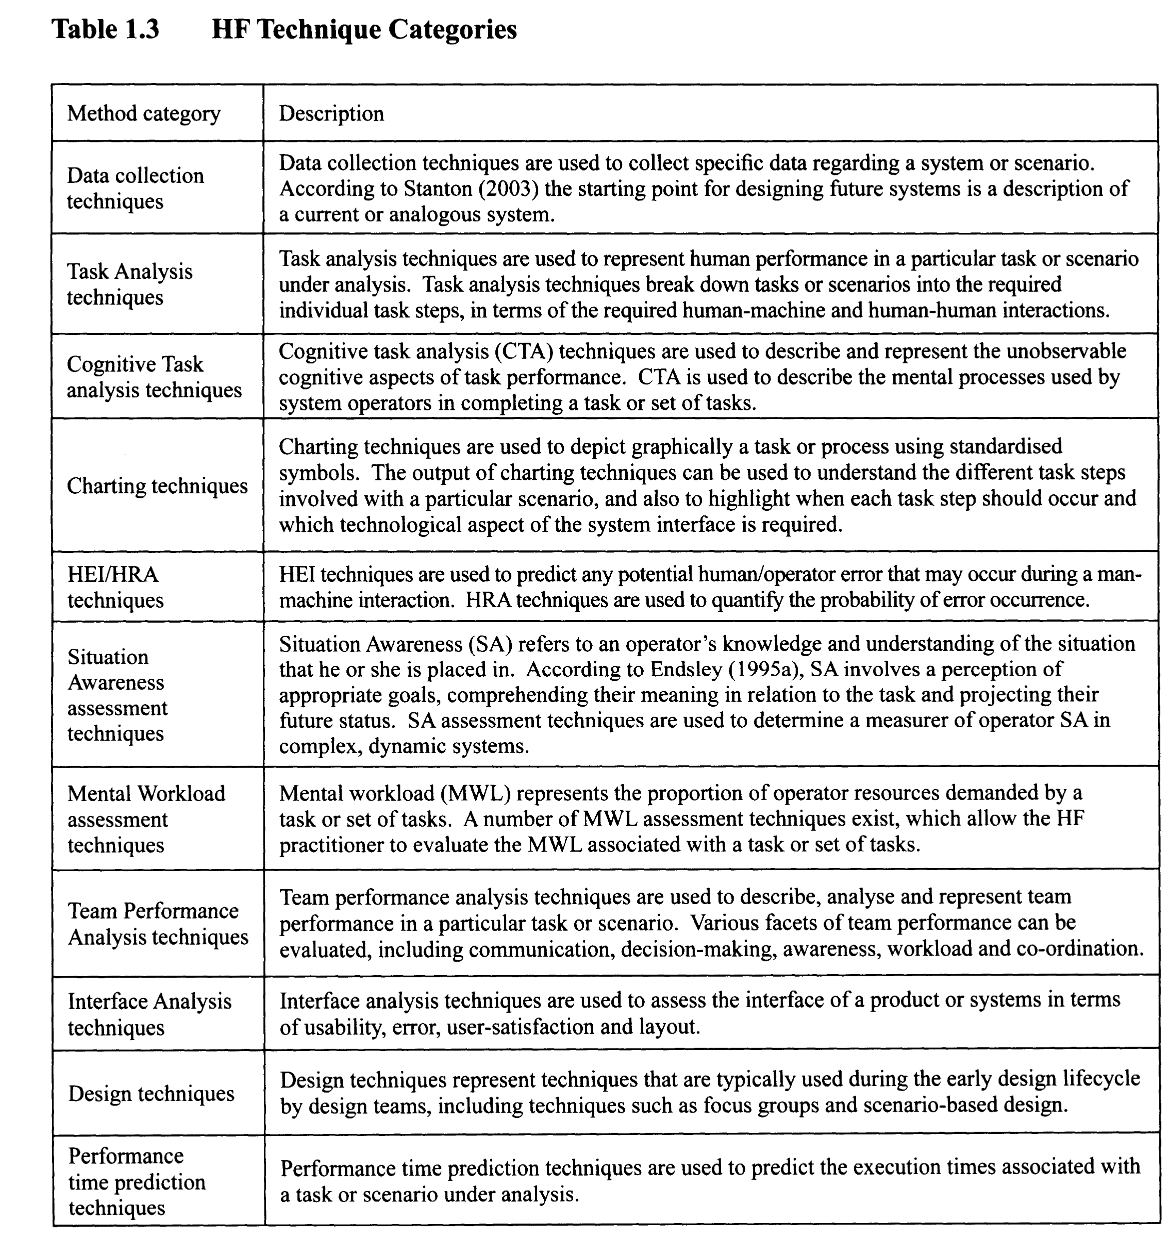

Slide 6
Task Analysis Techniques
Technique - Author/Source
HTA - Hierarchical Task Analysis - Annett et al (1971)
CPA - Critical Path Analysis - Newell and John (1987); Baber and Mellor (2001)
GOMS - Goals, Operators and Selection Methods - Card Moran and Newell (1983)
VPA - Verbal Protocol Analysis - Walker (In Press)
Task Decomposition - Kirwan and Ainsworth (1992)
The Sub Goal Template (SGT) Approach - Schraagen, Chipman and Shalin (2003)
Tabular Task Analysis - Kirwan (1994)

Slide 7
Example of a HTA

Slide 8
Cognitive Task Analysis Techniques
Technique Author/Source
ACTA - Applied Cognitive Task analysis - Militello and Hutton (2000)
Cognitive Walkthrough- Anon
CDM - Critical Decision Method- Klein (2000)
Critical Incident Technique - Flanagan (1954)

Slide 9
Charting Techniques
Technique Author/Source
Process Charts - Kirwan and Ainsworth (1992)
Operational Sequence Diagrams
DAD - Decision Action Diagram - Kirwan and Ainsworth (1992)
Event Tree analysis - Kirwan and Ainsworth (1992)
Fault Tree analysis - Kirwan and Ainsworth (1992)
Murphy Diagrams - Kirwan (1994)

Slide 10
Human Error Identification/Human Reliability Analysis
Technique- Author
CREAM - Cognitive Reliability Error Analysis Method- Hollnagel (1998)
HEART - Human Error Assessment and Reduction Technique - Williams (1986)
HEIST - Human Error Identification In Systems Tool - Kirwan (1994)
HET - Human Error Template - Marshall et al (2003)
Human Error HAZOP - Whalley (1988)
SHERPA - Systematic Human Error Reduction and Prediction Approach - Embrey (1986)
SPEAR - System for Predictive Error Analysis and Reduction - CCPS (1994)
TAFEI - Task Analysis For Error Identification - Baber and Stanton (1996)
THEA - Technique for Human Error Assessment - Pocock et al (2001)
The HERA Framework - Kirwan (1998a, 1998b)
TRACer - Technique for the Retrospective and Predictive Analysis of Cognitive Errors in Air Traffic Control (ATC) - Shorrock and Kirwan (2000)

Slide 11
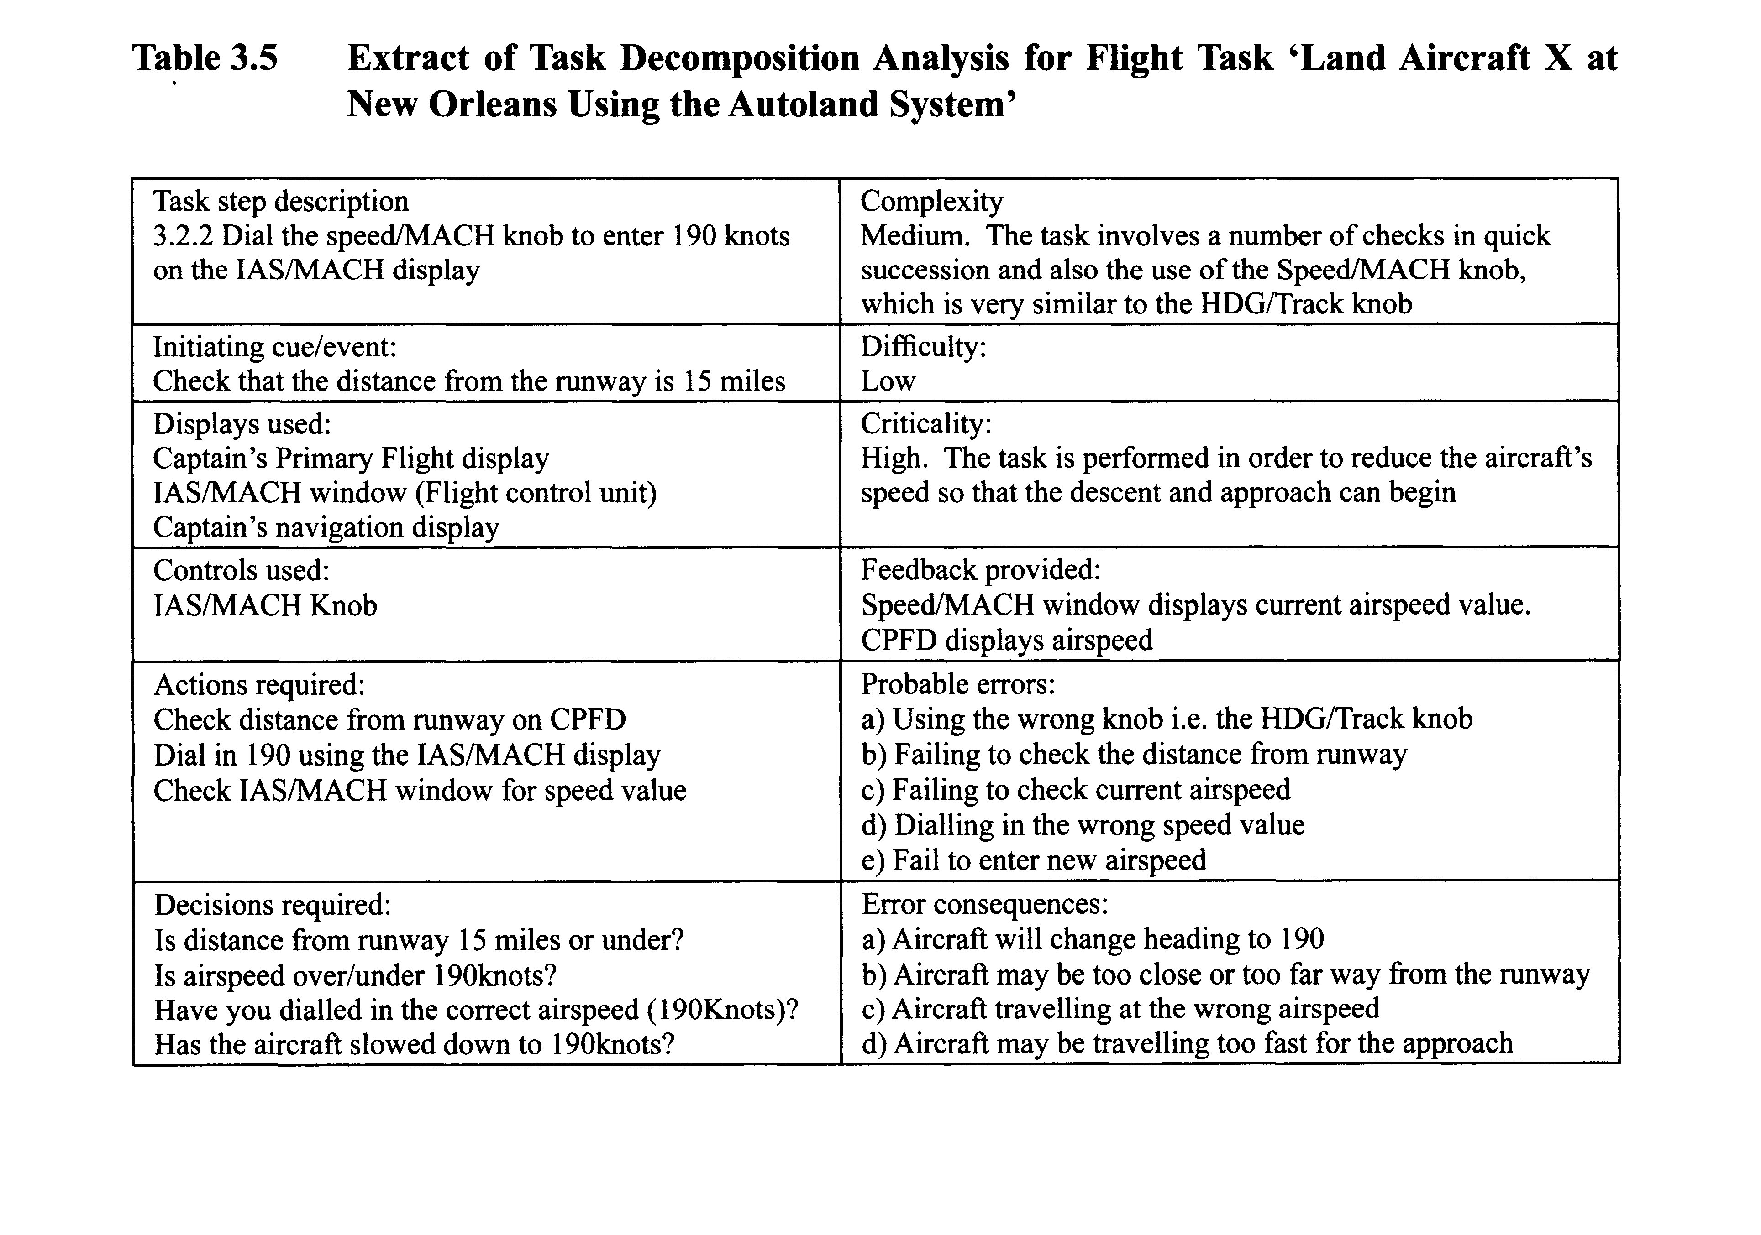

Slide 12
Process charting method

Slide 13
Case study
Game systems for Neurorehabilitation
Goals: Make motor therapy motivating; biofeedback for progress monitoring.
Operators: Movement/exercise of upper/lower limb; center of gravity – balance;
Methods: Integrate game interface into existing exercise equipment. Use sensors signal to control game.
Selection rules: selected low-cost off the shelf components but designed user-friendly and culture specific games.

Slide 14
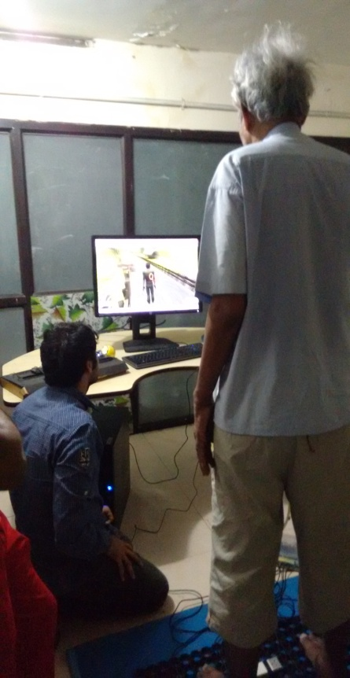
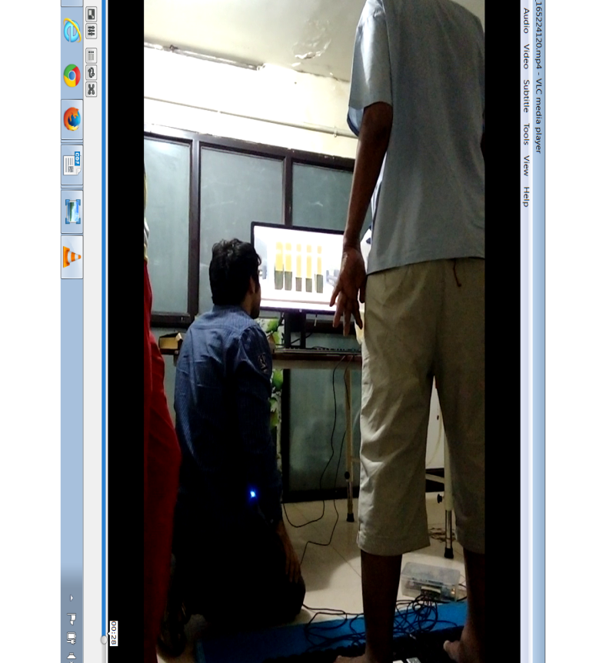
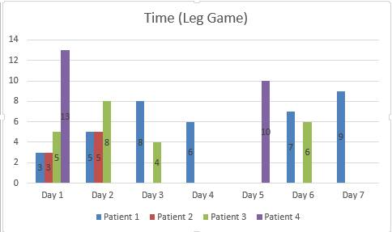
Case 1: Compelled weight shift and step back/forward
The histogram that
shows the scores
and the individual
leg movement.
The first person running game interface.
The pressure sensing mat
Patient: Loss of movement in lower limbs and hand due to paralysis
due to an accident. Age: 62 years.
The histogram shows the time
at each trail in minutes over a period of 7 days by 4 patients.
Patient 1 (blue bar) , shows increase over the trail period.
TOTAL COST: Rs. 7000/-.

Slide 15
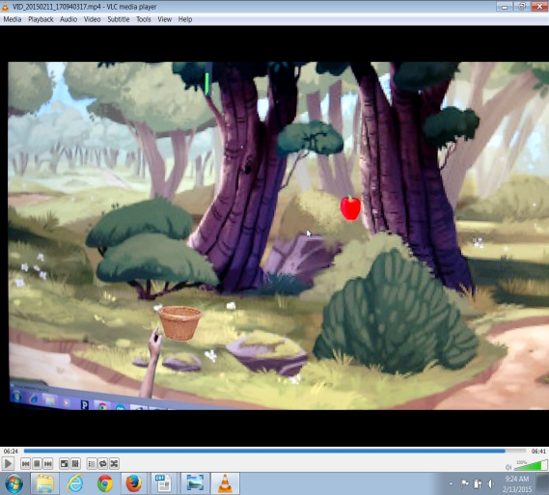
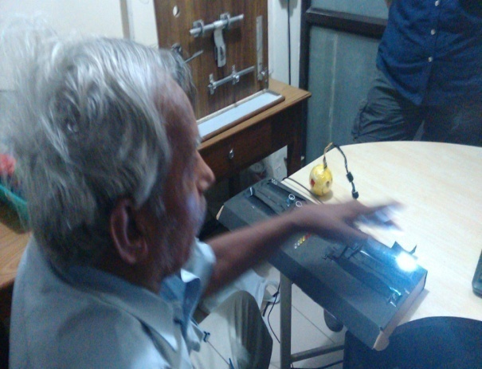
Hand Game
Goal: Arm swing and finger pressure.
Design: Sensors pick up movement of the arm and a rubber ball embedded with a pressure sensor collects finger pressure from a squeeze while also providing tactile feedback.
Game: The movement of the arm across two sensors placed apart (variable) controls a virtual basket to collect falling apples. The pressure from the squeeze device ensures the that the apple falls into the basket.
Block Diagram:
Ultra Sonic Sensor
PC/Arduino
Game
Flexi Force Sensor
Tactile feedback: ball with
embedded pressure sensor
The Board with sensors.
The yellow ball with
embedded sensor.
The game interface
showing the basket and the apple

Slide 16
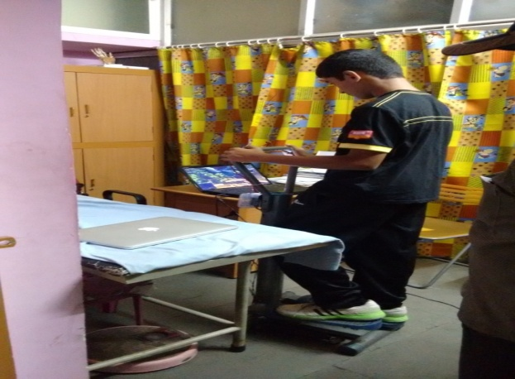
Games customized for patients
The power of belief & hope in medical cure has been accepted as beneficial in addition to medical interventions.
Considering that stroke & accident patients have difficulty in undertaking strenuous pilgrimages like climbing the Tirupathi hill to reach the temple, a virtual game mimicking the climb was developed.
The patient uses a regular staircase climbing exercise equipment fitted with sensors. The sensors detect the climbing motion, while the pulse rate & ECG in sensors help in monitoring the stress levels.
The game shows the stairs as in the real temple, with many smaller temples along the path. A reward on blessing scale for every smaller temple visit and health bar based on their pulse-rate and ECG readings are the game elements/controls.
The game on a smaller screen.
Actual display can be virtual reality glasses.
The sensors under the foot pedal
Steps with intermediate instructions
The ‘red’ and ‘blue’ bars on the left
are the pulse rate
derived health condition
Patient login screen
The intermediate small temples

Slide 17
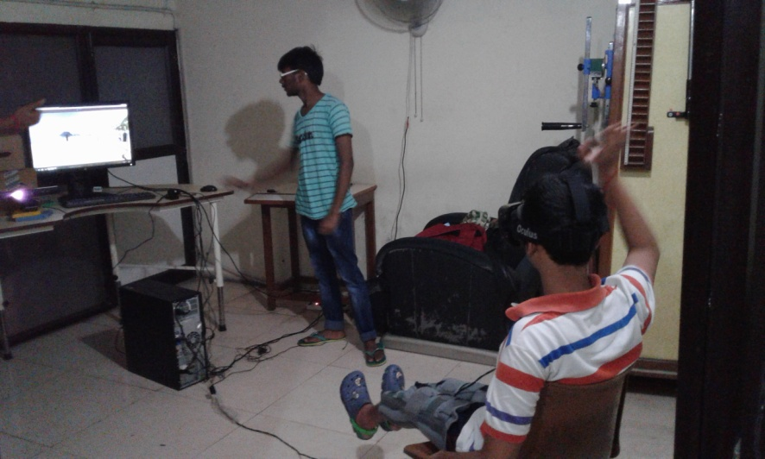
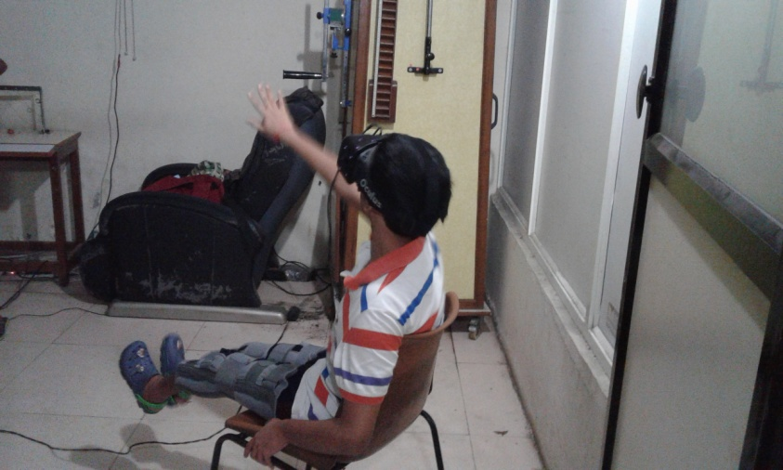
Virtual Reality
The game is projected on to VR glasses, and gestures imitation real-life game actions are collected by a Kinect sensor.
For patients not comfortable with VR (dizziness), Kinect alone can be used.
Played in the first-person perspective the hand (animated version of the patient’s hand) can be shown contralaterally– to induce the mirror effect.
Trail of a volleyball game being tested at
Anurag Rehab Center.by a MS patient

Slide 18




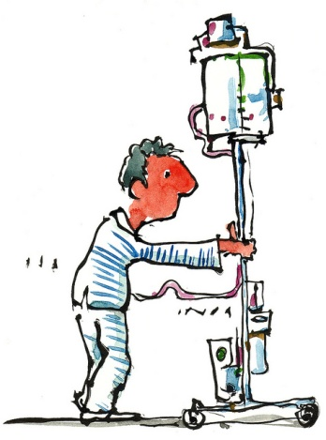
Internet
/mobile network
Sensors/control system /interface code
To reduce cross-contamination,
wearable sensors were not considered.

Slide 19
The uniqueness of the proposed systems
Cost effective
Modular, the same hardware can be used in many exercises.
The hardware signals integration to any game is easy. This making game development for open-source.
The diagnosis can be remote. Data for each patient can be transferred over internet or mobile to a remote doctor.
Youth in rural areas can start therapy center which can also double as regular gyms, making it profitable.
The system can be expanded for cognitive therapy in patients with age related conditions like dementia and arthritis.
And most importantly, elderly population in urban and rural areas can avail affordable scientific rehab sessions at local nodes.

Slide 20
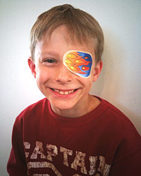
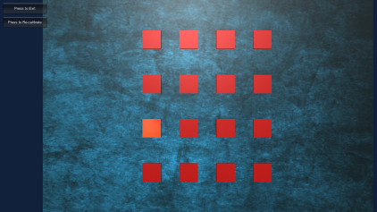
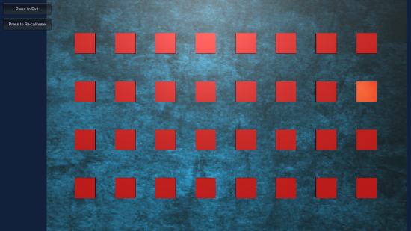
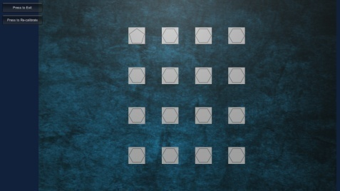
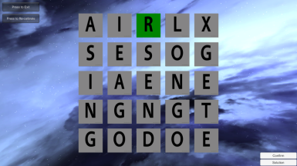
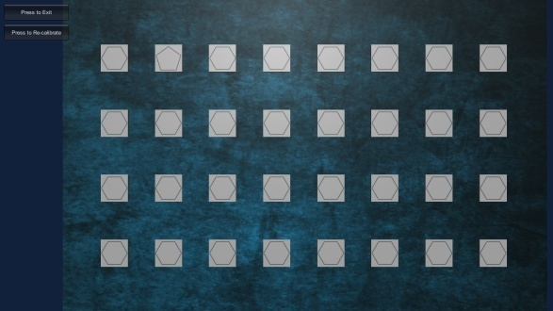
Games for Amblyopia
Collaborators: Dr Prema Nandini,Dr Ramesh of LVPEI.
Requirement: An immersive medium for eye exercises for amblyopic conditions in children. The treatment is to get the child to use the ‘lazy’ eye.
Present method: patch the good eye. Console based exercises by keyboard/mouse interaction.
Design: A set of exercises that requires the child to select the correct answer by eye movement only – collected by an inexpensive $100 eye tracker.
Data : Left/right eye fixation position and scan path analysed in real-time to determine scores and rewards. The left/right eye fixation position and difference at each level of the game is provided to the doctors.
Left/right eye fixation position
Word Search

Slide 21
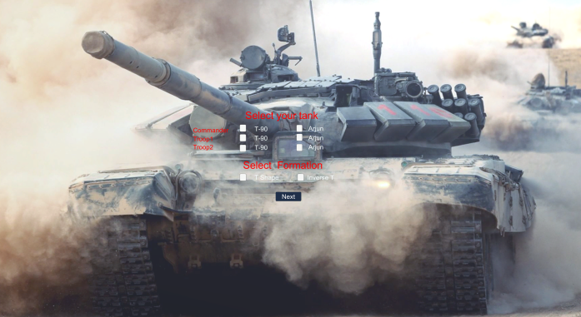
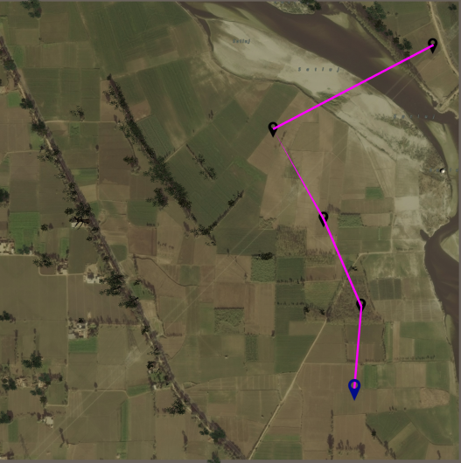
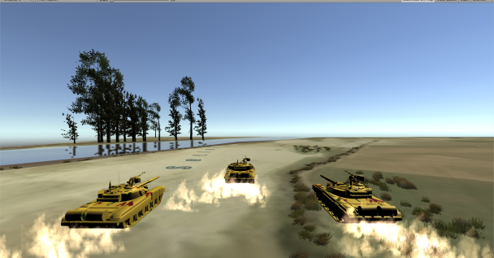
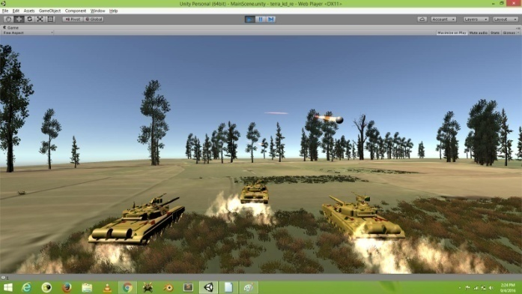
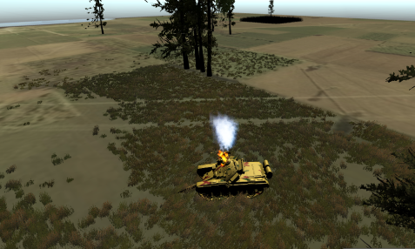
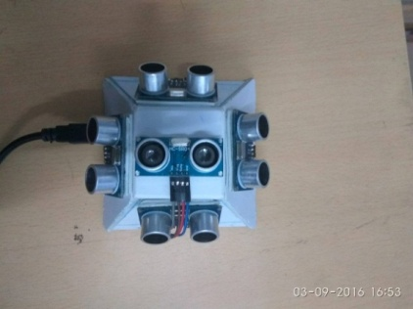
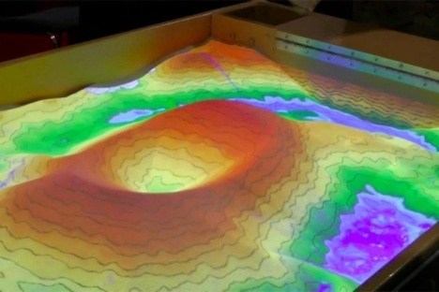
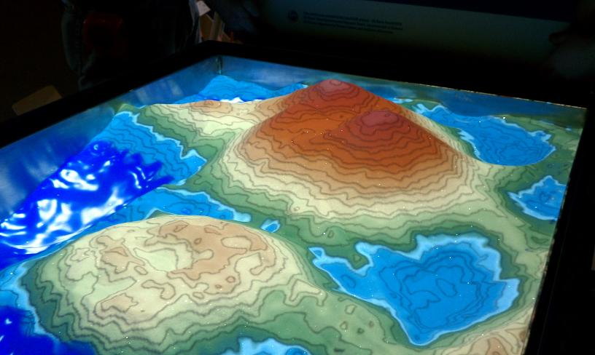
Strategy training exercise games for AC&S, Ahmednagar
Developed in UNITY.
Terrain composition from online maps
– hence issues with object height estimation.
Army has to give us high-res maps.
Based on a complete training exercise.
Ported to Virtual Reality.
1st person and Bird-eye view integrated.
Final steps:
Building an AR sandtable

Slide 22
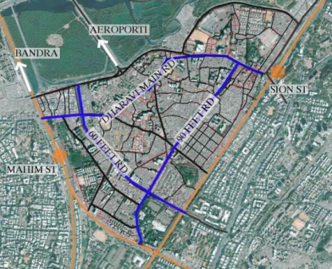
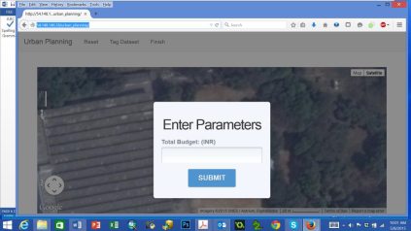
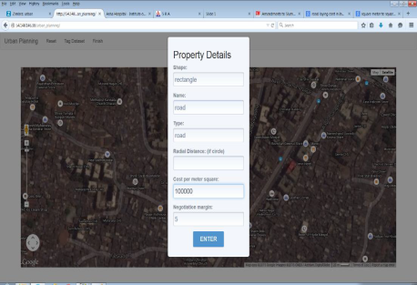
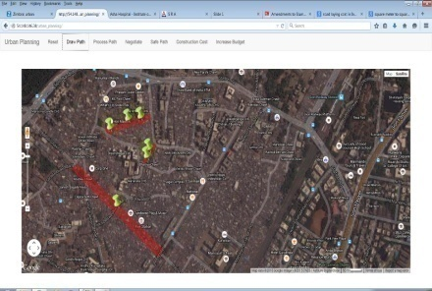
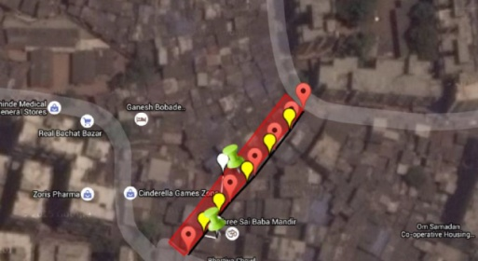
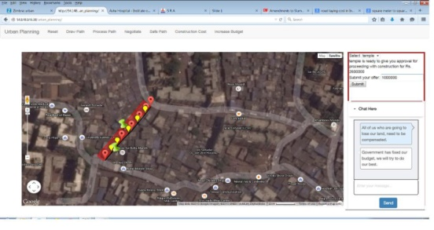
Games for interactive urban planning
Multi-agent behavior models for Urban planning
Aim: A game like platform for community driven urban planning. Testing for cognitive/perceptive aspects like: negotiation, decision making considering emotions/irrational behavior in addition to payoffs. Cognitive-affective map of modernist values of urban planning.
Status: Tested with urban planning architects in India/outside. Require more information from government agencies – need to find a way to acquire this information.
Case study 1: Planning a new road through existing properties

